Slide 1
M.KUMARASAMY COLLEGE OF ENGINEERING , DEPT OF CSE – B.E – [ 2019- 2023 ] Batch
Date & Session : 11 April 2023
Batch Number : 07

Slide 2
Artificial Intelligence For Skin Lesion Classification
Name of the Candidates : Aarthi Nivetha S
Dhivya V
Kaaviya A
Register Numbers : 19BCS4001
19BCS4025
19BCS4049
Name of the Supervisor : Mrs.A.Selvi AP/CSE
with Designation

Slide 3
Objectives of the Project
The main objective is to classify the skin cancer using AI deep learning techniques with improved accuracy
Skin Cancer is a disease affecting the skin. Skin cancer may appear as malignant or benign form.
The correct identification of skin spots based on certain features is the key steps in detecting the skin cancer disease in advance.
18CSP401L - PROJECT WORK Final REVIEW PRESENTATION

Slide 4
Objectives of the Project Contd..
In the proposed work, include the features extraction and classification.
The features extraction includes HSV color features, Texture features.
Using active contour based model to segment the skin features
After that implement Convolutional neural network algorithm is used to classify the features as affected or normal.

Slide 5
Introduction to Project
Skin diseases are more common than other diseases. Skin diseases may be caused by fungal infection, bacteria, allergy, or viruses, etc.
The correct identification of skin spots based on certain features is the key steps in detecting the skin disease in advance.
In the proposed work, include the features extraction and classification.

Slide 6
Introduction to Project Contd..
The features extraction includes HSV color features, Texture features.
After that implement Convolutional neural network algorithm is used to classify the features as affected or normal.

Slide 7
Related Works
S.No | Authors & Years | Title of the paper | Methodology | Merits
1 | T. Y. Satheesha 2017 | Melanoma Is Skin Deep: A 3D Reconstruction Technique for Computerized Dermoscopic Skin Lesion Classification | 3D reconstruction technique | Inadequate data
2 | N. Gessert 2020 | Skin Lesion Classification Using CNNs With Patch-Based Attention and Diagnosis-Guided Loss Weighting | CNN | Required more data

Slide 8
Related Works Contd..
S.No | Authors & Years | Title of the paper | Methodology | Merits
3 | Y. T. Xie, J. P. Zhang | Mutual Bootstrapping Model for Automated Skin Lesion Segmentation and Classification | Deep learning | Difficulty in interpretation
4 | Y. D. Yuan, M. Chao | Automatic Skin Lesion Segmentation Using Deep Fully Convolutional Networks with Jaccard Distance | CNN | Need for large amounts of labelled data

Slide 9
Related Works Gap Findings
Proposes image segmentation scheme based on an algorithm, Support vector Machine (SVM) and Super pixel segmentation algorithm
Implemented Principal component analysis algorithm to extract the features.
And also implemented unsupervised method to classify the skin diseases

Slide 10

Proposed System Architecture
For skin lesion segmentation, we propose the MSAU-Net, an attention-incorporated U-Net model.
The below figure provides an overview of our proposed network.
The encoder module is used to extract the hierarchical representation in our structure, and the attention mechanism is used to perform the non-linear feature re-calibration process.

Slide 11
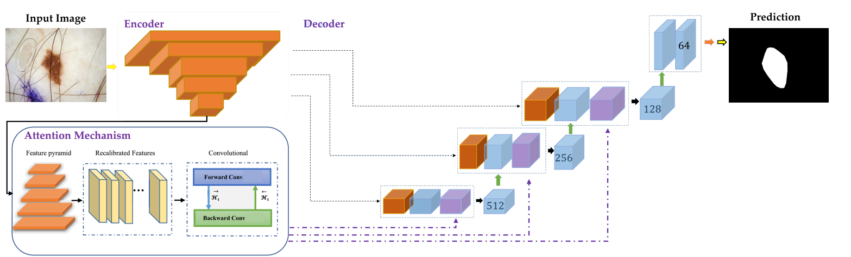
Proposed System Architecture

Slide 12
Software & Hardware Requirements Specification
Software Specification
Operating System: 64-bit Microsoft Windows 11, 10, 8, 7 (SP1)
Frond End : Python
Back End : MYSQL (WAMP Server)
IDE : PyCharm 2019.3
Tool : Python 3.7

Slide 13
Modules in Project
Input Image Pre-processing
Data Augmentation
Segmentation and Features Extraction
Prediction Output
Implementation Result

Slide 14
Summary of Module -1
INPUT IMAGE PRE-PROCESSING
In this module, we can input the dermoscopic skin images to analyze the diseases.
Dermoscopy is the examination of skin lesions with a dermatoscope.
It was necessary to extract the region of interest (ROI) and eliminate any redundant or unnecessary regions from each image because the resolution of all lesion images is greater than 299 X 299 pixels.

Slide 15
Summary of Module -2
DATA AUGMENTATION
This is equivalent to rotating, flipping, and cropping the image for the purposes of image classification.
In order to make the most of our limited training samples and boost the accuracy of the model, a number of random modifications were added to the ISIC dataset.
Additionally, the goal of data augmentation is to enhance the model's ability to generalize and prevent over fitting—a common issue in artificial intelligence involving datasets in which the model learns patterns that do not apply to new data.

Slide 16
Summary of Modules -3
SEGMENTATION AND FEATURES EXTRACTION
Algorithms currently in use only calculate numeric values and necessitate manual feature extraction and preprocessing.
We employ the transfer learning algorithm AttentionU-NET and ResNet, which is a specialized version of CNN
To bypass these time-consuming steps and enable the algorithm to perform the feature extraction itself.
A snake is an energy minimizing, deformable spline influenced by constraint and image forces that pull it towards object contours and internal forces that resist deformation.

Slide 17
Summary of Modules -4
PREDICTION OUTPUT
The classification is the final step of the system.
After analyzing the structure, each section individually evaluated for the probability of true positives.
Skin diseases are classified using Convolutional neural network algorithm.
So our proposed work overcomes irregular boundaries separation in skin image classification with improved accuracy

Slide 18
Summary of Modules -5
IMPLEMENTATION RESULT
We provide (i) information about the dataset, (ii) the metrics we used to evaluate our method, and (iii) a description of each output we used for our experimental evaluation in this section.
The proposed method is evaluated using the following evaluation tools: Specificity, F1_score, sensitivity (Recall), accuracy, and precision

Slide 19
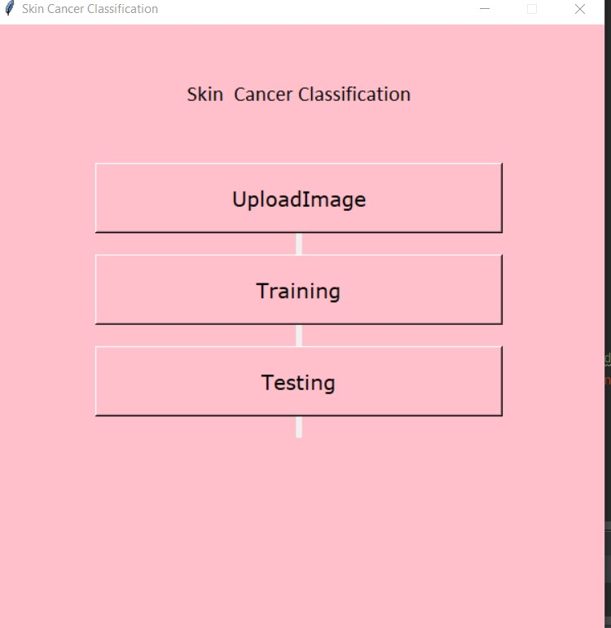
Demo of Implementations Module 1

Slide 20
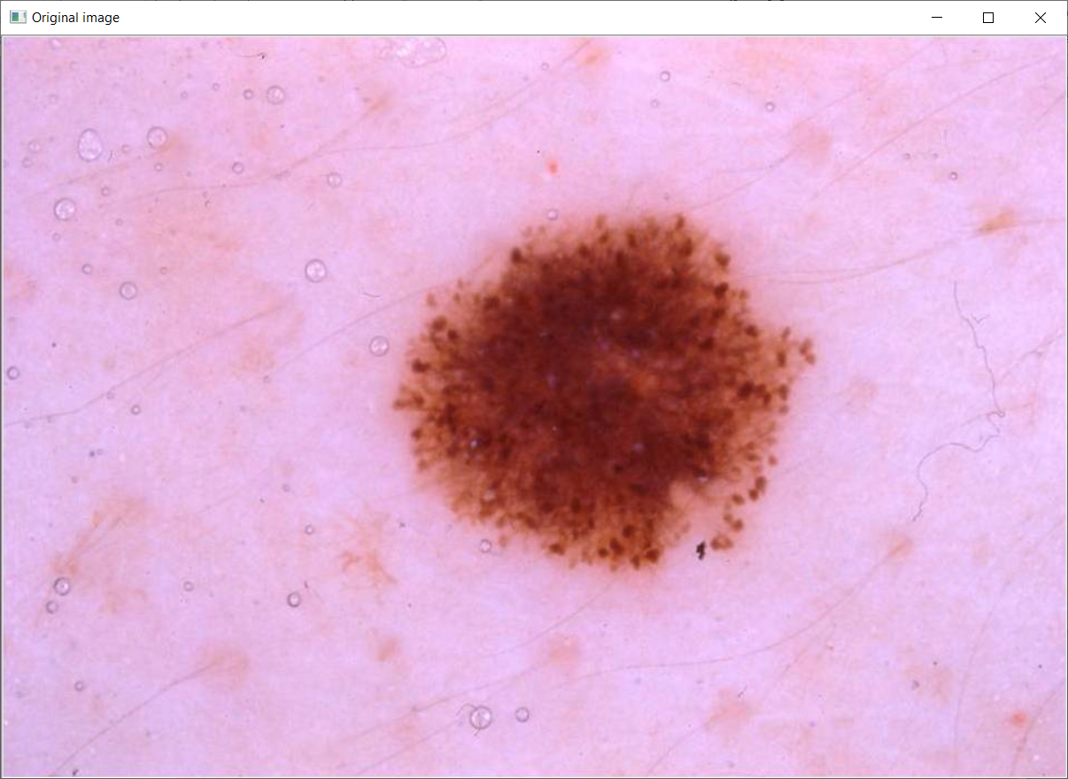
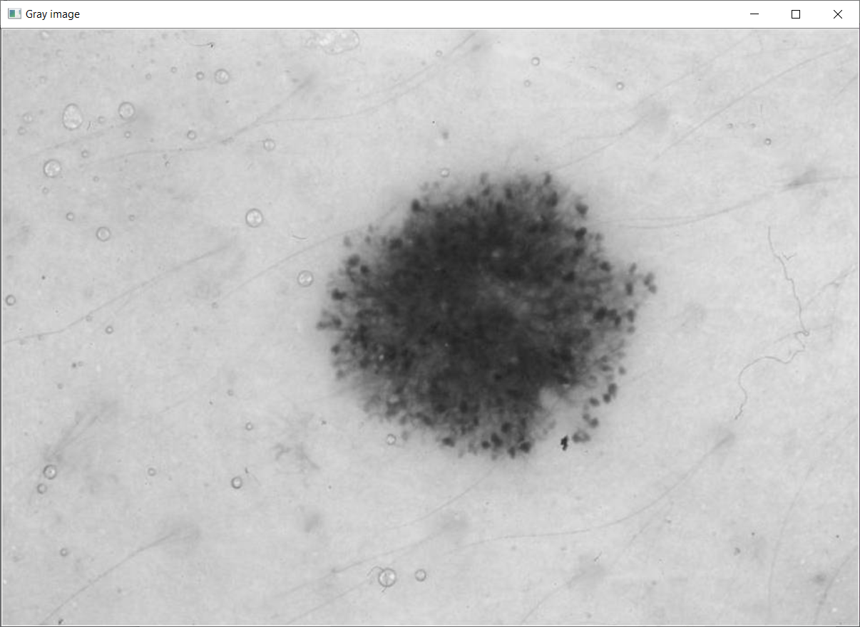
Demo of Implementations Module 2

Slide 21
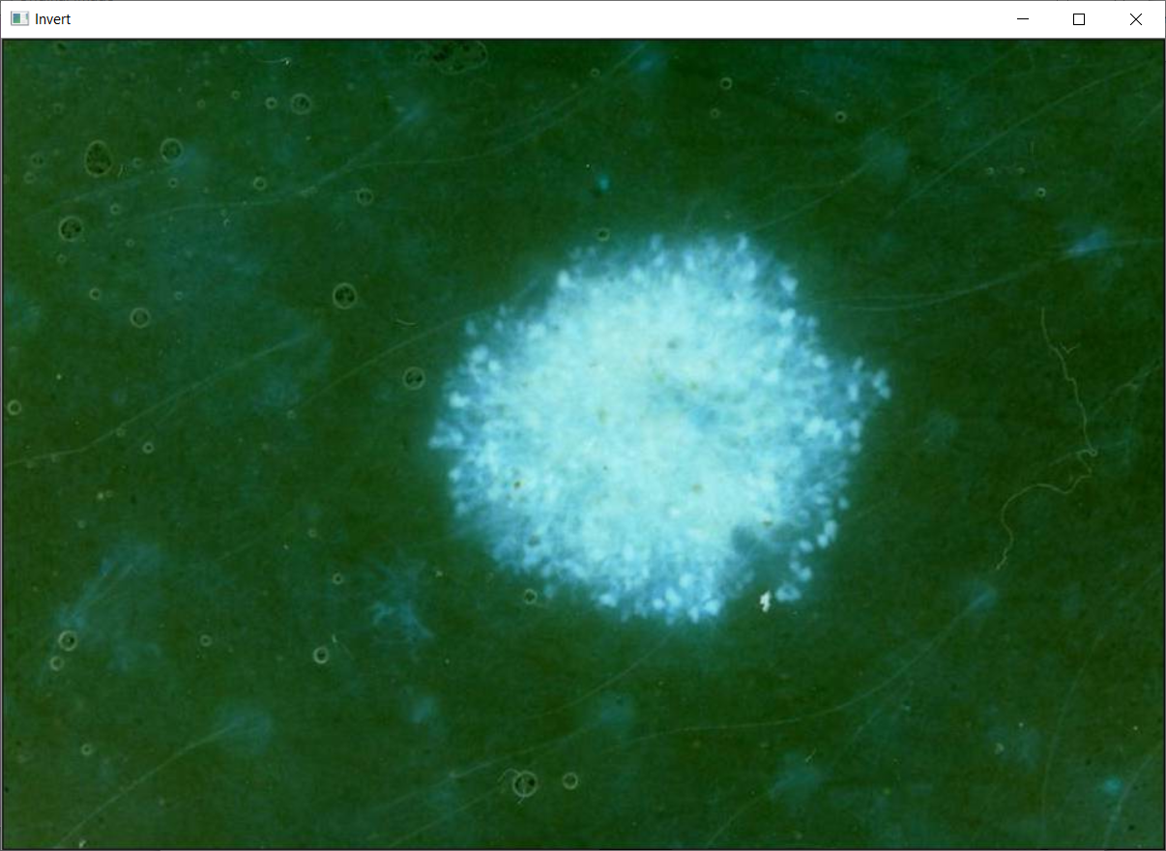
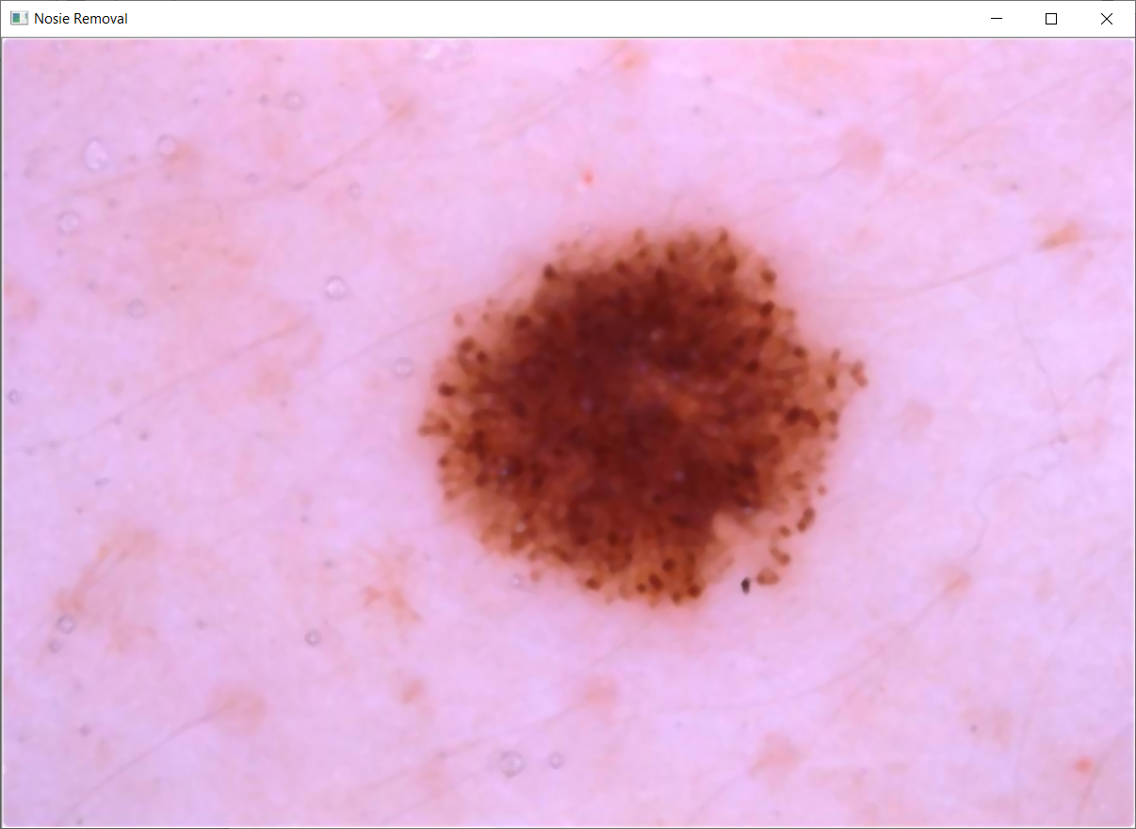
Demo of Implementations Module 3

Slide 22
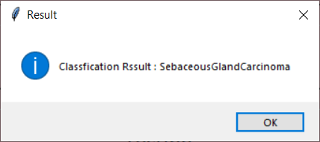
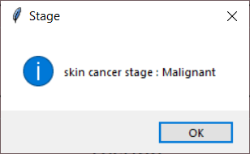
Demo of Implementations Module 4

Slide 23
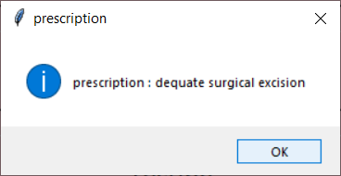
Demo of Implementations Module 5

Slide 24
Results & Discussion
The skin cancer detection is complicated by irregular forms of skin lesions, various types of colors on each skin, and defining the ROI on each dermoscopic picture.
In first part of the experiments, images are used that were pre-processed and feeding the algorithm.
This result is a good indicator for the potential of such a technology to classify predictions accurately and eventually help physicians increase their diagnostic prediction power.

Slide 25
Conclusion
Deep learning algorithm using the concept of Convolutional neural network is proposed.
A CNN is introduced based on a learned model of normal skin and lesion textures.
Representative texture distribution and color distributions are learned from the image itself and CNN algorithm is used to classify the skin cancer.
The features are extracted based on HSV color and statistical features.
So we can easily able to classify the skin cancer using our proposed method.

Slide 26
Future Works
In future work, we can extend the framework to implement various classification algorithms and also implement the framework to predict various diseases.
Unfortunately, it is difficult to compare different classification methods because some approaches use nonpublic datasets for training and/or testing, thereby making reproducibility difficult.

Slide 27
References
T. Y. Satheesha, D. Satyanarayana, M. N. G. Prasad, and K. D. Dhruve, “Melanoma Is Skin Deep: A 3D Reconstruction Technique for Computerized Dermoscopic Skin Lesion Classification,” IEEE J. Transl. Eng. Health Med., vol. 5, pp. 1-17, 2017.
N. Gessert et al., “Skin Lesion Classification Using CNNs With Patch-Based Attention and Diagnosis-Guided Loss Weighting,” IEEE Trans. Biomed. Eng., vol. 67, no. 2, pp. 495-503, Feb, 2020.
Y. T. Xie, J. P. Zhang, Y. Xia, and C. H. Shen, “A Mutual Bootstrapping Model for Automated Skin Lesion Segmentation and Classification,” IEEE Trans. Med. Imag., vol. 39, no. 7, pp. 2482-2493, Jul, 2020.
Y. D. Yuan, M. Chao, and Y. C. Lo, “Automatic Skin Lesion Segmentation Using Deep Fully Convolutional Networks With Jaccard Distance,” IEEE Trans. Med. Imag., vol. 36, no. 9, pp. 1876-1886, Sep, 2017.
L. Yu, H. Chen, Q. Dou, J. Qin, and P. A. Heng, “Automated Melanoma Recognition in Dermoscopy Images via Very Deep Residual Networks,” IEEE Trans. Med. Imag., vol. 36, no. 4, pp. 994-1004, Apr, 2017.

Slide 28
International Conference Details
A. Selvi, S. Aarthi Nivetha, V. Dhivya and A. Kaaviya, “Artificial Intelligence for Skin Lesion Classification : A Survey ”. 8th International Conference on Computing, Communication and Security (ICCCS-2023), Baba Farid College of Engineering and Technology, Punjab (Accepted for Publication in Lecture Notes on Smart Innovation, Systems and Technologies, Springer – SCOPUS).
Notes:
6

Slide 29
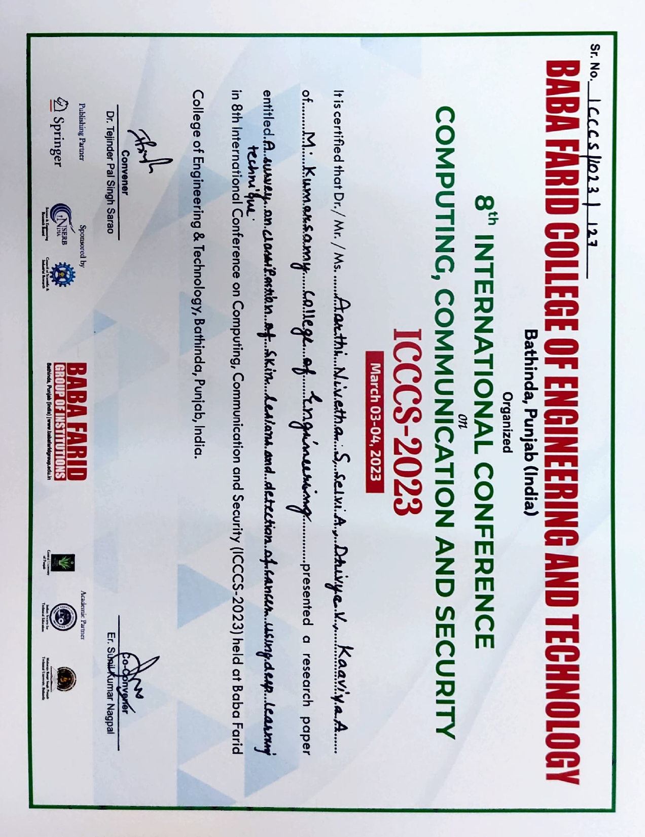
International Conference Certificates

Slide 30
Any Queries
Thank you

